Slide 1
What is a Data Pipeline?
A data pipeline is a systematic and automated process for the efficient and reliable movement, transformation, and management of data from one point to another within a computing environment.
It plays a crucial role in modern data-driven organizations by enabling the seamless flow of information across various stages of data processing.

Slide 2
Big data pipelines are data pipelines built to accommodate one or more of the three traits of big data.
The velocity of big data makes it appealing to build streaming data pipelines for big data. Then data can be captured and processed in real time so some action can then occur.
The volume of big data requires that data pipelines must be scalable, as the volume can be variable over time. In practice, there are likely to be many big data events that occur simultaneously or very close together, so the big data pipeline must be able to scale to process significant volumes of data concurrently.
The variety of big data requires that big data pipelines be able to recognize and process data in many different formats—structured, unstructured, and semi-structured.

Slide 3
Types of Data Pipelines
Batch Processing
Batch processing involves the execution of data jobs at scheduled intervals. It is well-suited for scenarios where data can be processed in non-real-time, allowing for efficient handling of large datasets.
Streaming Data
Streaming data pipelines process data in real-time as it is generated. This type of pipeline is crucial for applications requiring immediate insights and actions based on up-to-the-moment information.

Slide 4
How Data Pipelines Work
A typical data pipeline involves several key stages:
Ingestion Data is collected from various sources and ingested into the pipeline. This can include structured and unstructured data from databases, logs, APIs, and other sources.
2.Processing The ingested data undergoes processing, which may involve transformation, cleansing, aggregation, and other operations to prepare it for analysis or storage.
3.Storage Processed data is stored in a suitable data store, such as a database, data warehouse, or cloud storage, depending on the requirements of the organization.
4.Analysis Analytical tools and algorithms are applied to the stored data to extract meaningful insights, patterns, and trends.
5.Visualization The results of the analysis are presented in a visual format through dashboards or reports, making it easier for stakeholders to interpret and act upon the information.

Slide 5
Data Pipeline Architecture
A robust data pipeline architecture is essential for ensuring the effectiveness and scalability of the pipeline. Common components include:
Data Source
The origin of data, which could be databases, external APIs, logs, or other repositories.
Data Processing Engine
The core component responsible for transforming and manipulating the data according to predefined rules and logic.
Data Storage
Where the processed data is stored, ranging from traditional databases to fast data stores to hybrid cloud-based solutions.
Data Orchestration
The mechanism that coordinates the flow of data through the pipeline, ensuring that each step is executed in the correct sequence.
Data Monitoring and Management
Tools and processes for monitoring the health and performance of the data pipeline, as well as managing errors and exceptions.

Slide 6
Data Pipeline Considerations
Data Security
Ensuring the security and privacy of sensitive data throughout the pipeline is crucial to compliance with regulations and protecting organizational assets.
Scalability
The architecture should be designed to scale horizontally or vertically to accommodate growing data volumes and processing demands.
Fault Tolerance
Building in mechanisms to handle failures and errors gracefully is essential for maintaining the reliability of the pipeline.
Metadata Management
Effective metadata management is crucial for tracking the lineage and quality of data as it moves through the pipeline.
Performance
While there are use cases such as batch processing with relatively long processing windows, many times a data pipeline feeds mission-critical and time-sensitive operations such as payment processing or fraud detection. In those cases, fast performance and low latency are critical for the business to meet their required service level agreements (SLAs).

Slide 7
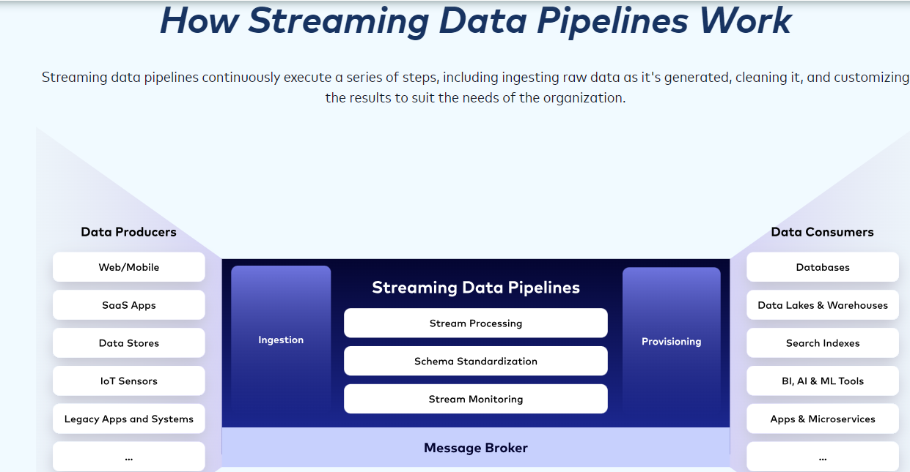

Slide 8
What Are Streaming Data Pipelines?
Streaming data pipelines move data from multiple sources to multiple target destinations in real time, capturing events as they are created and making them available for transformation, enrichment, and analysis.
For many applications, real-time and continuously fresh data is vital. Examples include:
1. Mobile banking apps
2. GPS apps that recommend driving routes based on live traffic information
3. Smartwatches that track steps and heart rate
4. Personalized real-time recommendations in shopping or entertainment apps
5. Sensors in a factory where temperatures or other conditions need to be monitored to prevent safety incidents
Streaming data pipelines enable continuous data ingestion, processing, and movement from its source(s) into its destination as soon as the data is generated in real time.
Similarly known as streaming ETL and real-time dataflow, this technology is used across countless industries to turn databases into live feeds for streaming ingest and processing to accelerate data delivery, real-time insights, and analytics.

